Slide 1
Hi presenter! Read me before using!
This webinar resource is almost ready for you to use! Be sure to:
Look through and add custom information
Slide #- Presenter slide
Slide #- Resource slide
Slide #- Thank you
There are presenter notes to help guide you- feel free to edit these for your
This resource can be customized. Here are some examples of how you can personalize this slide deck to suit the needs of your educators and staff:
Replace our images with screen shots from your environment
Read through slides and ensure terms and jargon will resonate with your board policies/ tool names in your Brightspace environment (i.e. Assignments vs Dropbox, Announcements vs News)
Add additional information to slides specific to your district, including how this helps meet district goals, improvements plans, strategic plans etc
Include your district logo on slides or change the colours used to match your district branding

Slide 2
Webinar Title
<insert date>
© 2020 D2L Corporation
Notes:
<update with date and customer logo with a white or clear background>

Slide 3
Presenter Name Title Company/Organization
@Twitter handle

Slide 4
Agenda
Point one
Point two
Point three
Etc.
Notes:
<update agenda>

Slide 5
Housekeeping Items
How can people ask questions?
Webinar recording and slide deck will be available on ___________

Slide 6
Text
Text
Text
Introduction to Topic Slide Opt 1
Text
Text
Text

Slide 7
Introduction to Topics Idea 2
Key point
Key Point
Key Point
Key Point
© 2019 D2L Corporation

Slide 8
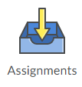
Brightspace Tools to help support topic:
Portfolio
Content
Activity Feed
Announcements
(AKA Newsfeed)
Assignments
(AKA Dropbox)
Purpose:
Purpose:
Purpose:
Purpose:
Purpose:
Multi-media capable tool to allow teachers to create rich announcements for students that post to the course homepage
Submission folders are found here
Students can track their assignments and see what has/has not been submitted, including due dates
Documentation tool to collect evidence of learning
Where you can find the lesson content that is being shared by the educator
Interactive tool for educators to share activities on the course homepage
Social media inspired communication tool

Slide 9
Webinar Topic Demo
Learning Objectives:
You will be able to:
Learning Objective 1
Learning Objective 2
Learning Objective 3

Slide 10
How-To Steps depending on demo- examples follow
1
2
Place your cursor in the top right corner of your Navbar. An options menu will appear. Click the menu.
Select “Edit This Navbar”

Slide 11
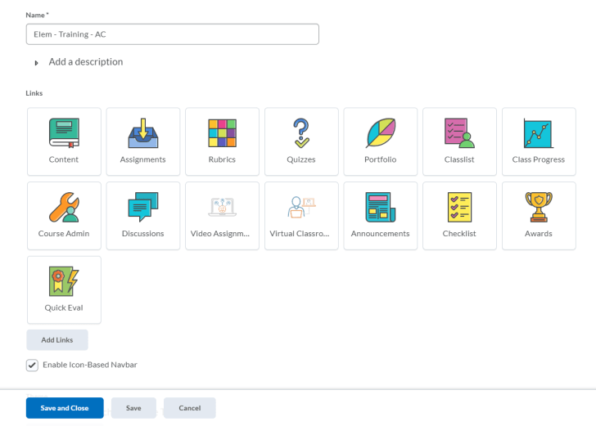
Edit your Navbar
1
2
Place your cursor in the top right corner of your Navbar. An options menu will appear. Click the menu.
Select “Edit This Navbar”

Slide 12
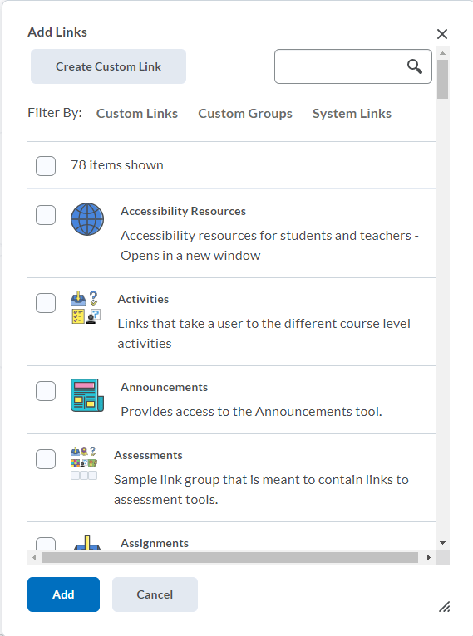
Edit your Navbar
1
2
Place your cursor in the top right corner of your Navbar. An options menu will appear. Click the menu.
Select “Edit This Navbar”

Slide 13
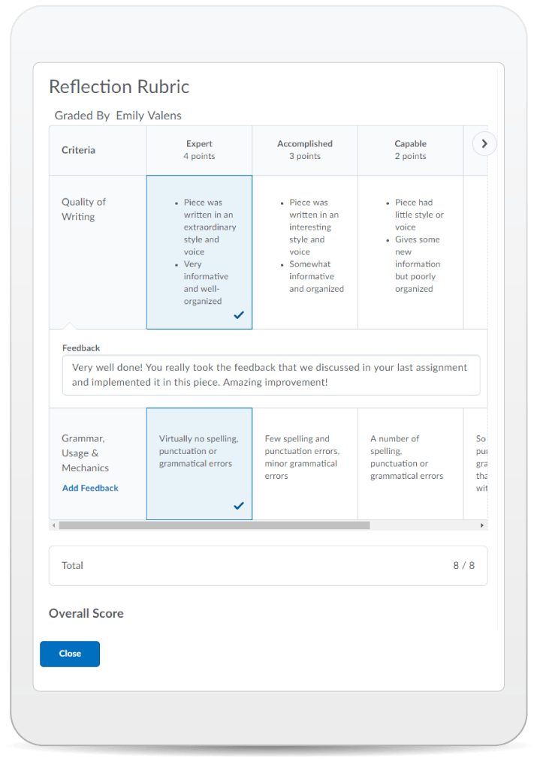
Learning Objectives:
Today you learned how to:
Learning Objective 1
Learning Objective 2
Learning Objective 3
© 2020 D2L Corporation
Notes:
<include this slide if you are sending the deck to the customer. It provides an overview of the features shown during the demo>

Slide 14
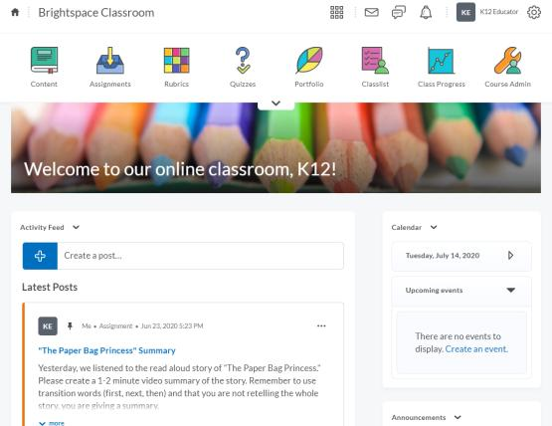
Give This a Try!
Take away activities suited to topic
Image to be customized based on topic

Slide 15
Resources
D2L resources based on webinar topic
Also where boards can add their own resources

Slide 16
Tutorial Videos
Communication and Collaboration | Organizing Course Materials | Documenting Student Learning | Feedback & Assessment
Announcements Activity Feed -Add Attachments and Links to Posts -Create an Assignment Post in Activity Feed -Customize Notifications for Activity Feed -For posting a message -Optimize Activity Feed Discussions | Content/Lessons Tool -Getting Started with Lessons for Instructors -Lessons: Add a New Unit and Lesson -Lessons: Add New Materials -Lessons: Reorder Units, Lessons, Folders, and Materials -Lessons: Attach a Release Condition Groups -Creating Groups -Creating Individual Student Groups -Creating Unique Learner Pathways | Brightspace Portfolio -Review and Approve Portfolio Items -Oversee and View Individual Portfolios -Brightspace Portfolio: Bring Your Own Device (for learners) -Portfolio AT HOME Assignments Discussions Quizzes -Quiz Question Converter | Rubrics -Create an Analytic Rubric -Create a Holistic Rubric Grades -Entering Grades -Associate an Activity with a Grade Item -Create a Grade Scheme Standards/Expectations -Standards: Import Standards from Course Admin Assessing or Evaluating Against Expectations Quick Eval
Notes:
There are also many quick tutorial videos available! These resources are organized pedagogically. Every underlined item is linked to a tutorial video

Slide 17
Thank you!
@Twitterhandle
© 2020 D2L Corporation

Slide 18
Thank you!
@Twitterhandle
© 2019 D2L Corporation

Slide 19
Thank you!
@Twitterhandle

